Slide 1
What is matter?
All matter is composed of atoms!
Just how small are these atoms?

Slide 2
A quick gamble..
Would I better off with $1000 or… A million gold atoms A billion gold atoms A gold atom for every second since the beginning of time

Slide 3
What are atoms?
Ripping aluminum foil?
Cutting sandwiches?
Look at figure 2.1 on page 16
Is it possible to see these atoms with any kind of optical device?

Slide 4
Discovery
If they’re so small then how did were they discovered?

Slide 5
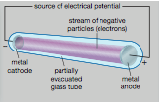
Discovery – 1850s
Cathode ray tube
Sealed glass tube containing gasses at low pressures
Anode at one end, cathode at other end
When electricity is supplied, a “cathode ray” is observed.

Slide 6
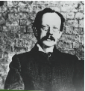
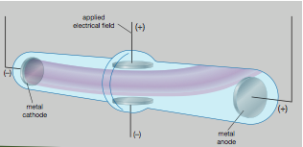
Discovery Jospeh Thompson – 1809s
Repeated cathode ray experiments using different metals as the electrodes and different gasses (results were the same each time)
Used magnets to “bend” the cathode ray (what does this tell us?)
What can we imply about cathode rays from these experiments?

Slide 7
Thompson’s propositions
Observed rays were a stream of particles shooting out from the cathode (negatively charged)
Because the particles emanated out from the negative electrode, and because they bent away from a negative pole of an electric field, the particles must be negative
These negative particles must be common to all elements; they must be ‘sub-atomic particles. These negative particles, are much smaller than atoms and are called electrons

Slide 8
JJ Thompsons
Read out the section on page 17
Atoms are overall neutral, therefore they must contain a positive charge which balances the negative charge (protons)
Mass of positive matter is 1700x greater than negative matter
All atoms in an element weigh the same amount

Slide 9
Atomic models
What is a model?
Why are they used?

Slide 10
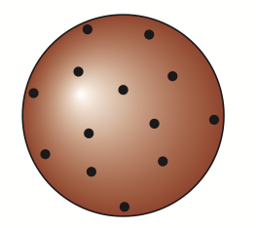
Atomic models
Thompson's Plum Pudding! (1897)
Positive charged ball with negative charged particles randomly embedded (like a plum pudding)
Consisted of protons and electrons

Slide 11
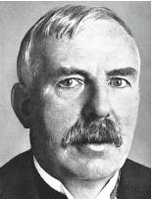
Atomic models
The Nuclear atom – Ernest Rutherford1900s
As elements decay (break apart) they release alpha particles (radioactive)
He fired these alpha particles at ultra thin gold foil
Most particles went straight through, however 1 in 8000 was deflected off the foil..

Slide 12
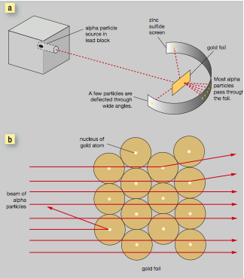
Atomic models

Slide 13
Rutherford's deductions
What could Rutherford deduce from these experimental findings?

Slide 14
Rutherford's deductions
Most of the volume of an atom must be empty space
Most of the mass of an atom must be located in the centre of the atom, he called this the nucleus.
The electrons occupy the empty space, and revolve around the nucleus in a circular motion.
The small proportion of alpha particles which “bounced” off the foil were repelled by the positively charged proton
According to this model, the radius of an atom is 10⁻¹⁴ m
If the MCG was an atom, the nucleus would be the size of a marble in the centre, with the electrons spinning round the outside edges

Slide 16
A problem…
If hydrogen contained 1 proton and electron, and had the relative atomic mass of 1, then helium should have 2 protons and 2 electrons, and have a RAM of 2, however, its mass was four times that of hydrogen.
Rutherford later changed his to include another sub-atomic particle, which had a similar mass to protons, but no charge.

Slide 17
Discovery of a Neutron
James Chadwick (1932) labeled the uncharged particle a Neutron.
Hence a helium atom, 4X heavier than hydrogen, contained a 2 protons and 2 neutrons.

Slide 18
Backing up the theory
Rutherford had identified a radioactive element called thorium, and another with almost identical chemical properties, e labeled this Thorium-X. Frederick Soddy studied this element, and decided that ti was indeed the same element as thorium, but it contained an extra neutron, hence the RAM was slightly different. He called this an Isotope.

Slide 19
Isotopes
Isotopes of an element contain the same number of protons and electrons, but a different number of neutrons!

