Slide 1
Carbohydrates

Slide 2
Carbohydrates
The name ‘carbohydrate’ is derived from the observation that many members of this group have the empirical formula
C_{x}(H₂O)_{y}, where x and y are whole numbers

Slide 3
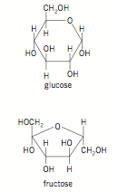
Monosaccharides (1 sugar)
Glucose is one of the simplest of the carbohydrate type known as monosaccharides (simple sugars). Fructose, the sweetest sugar known, found in fruits and honey, is another. All are white, crystalline solids with a sweet taste, and all have the formula C₆H₁₂O₆, that is, they are structural isomers.

Slide 4
Disaccharides
Disaccharides (double sugars) form by condensation reactions between two monosaccharides. In common with the condensation reactions seen in chapter 7, the small molecule eliminated in the reaction is water. The link formed is known as an ether link, while the product formula is C12H22O11. Sucrose, the most common disaccharide, is added as a sweetener to foods.

Slide 5
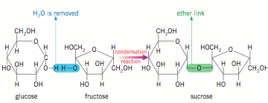
Formation of sucrose
Carbon 1 and 4

Slide 6
Polysaccharides
The condensation reaction between monosaccharides does not necessarily stop with the disaccharide. The reaction may continue on to produce a polymer, a polysaccharide containing thousands of glucose units. These polysaccharides are less soluble than the smaller saccharides and do not have a sweet taste.

Slide 7
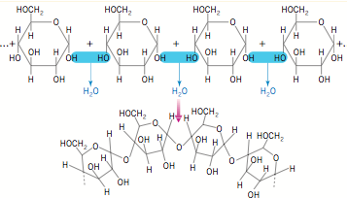

Slide 8
Polymerisation in nature
Polymerisation of glucose in living things can produce three different polysaccharides: starch, cellulose and glycogen. How can the same monomer produce different polymers? The answer to this lies in the fact that glucose has two forms, depending on the orientation of the hydroxy groups. One form is called α-D-glucose and the other β-D-glucose.

Slide 9
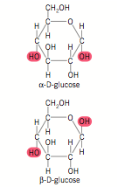

Slide 10
Starch
One of the different forms of polymerized glucose is starch which is a food source for animals and a food store for plants. Foods like potato and sago are well known for their high starch content.

Slide 11
Cellulose
Cellulose is the most abundant molecule in living tissue, making up around half of the total organic carbon in the biosphere. It is a structural polysaccharide, found in the walls of plant cells. Cotton is almost pure cellulose, while wood is around half cellulose. The cellulose polymer is a straight-chain molecule, with these molecules acting rather like stiff rods. Extensive hydrogen bonding between the molecules produces a strong material.

Slide 12
Glycogen
The third polysaccharide formed by glucose is glycogen, a highly branched polymer. Animals store some excess energy as glycogen. It is stored in muscle and the liver, and serves as a ready, short-term store of energy. The long-term energy store is in the form of lipids (see page 186), as they contain more energy per gram than carbohydrates.

Slide 13
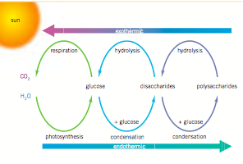

Slide 14
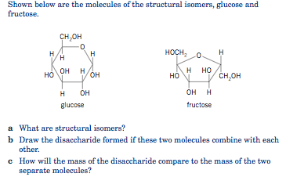

Slide 15
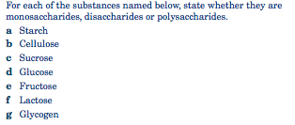

Slide 16
Proteins
These are polypeptides…
Proteins have many different functions in living things. For example, they act as biological catalysts (enzymes), they give structure (hair, muscle, feathers and nails), they provide energy and, in some cases, they are hormones.

Slide 17
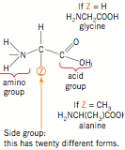
Structure
Proteins are polymers of α-amino acids, the general structure of which is shown below

Slide 18
Facts…
Plants are able to synthesise these amino acid monomers from CO2, H2O and minerals such as NO3− and SO42−. Notice that in their general structure amino acids contain both an acidic group (–COOH) and a basic group (–NH2). Thus, depending on the surroundings, an amino acid may act as an acid or a base, donating or accepting a proton respectively.

Slide 19
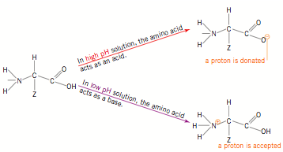
Acid/Base structure

Slide 20
Reactions
Two amino acids may undergo a condensation reaction. Reaction occurs between the −NH2 and −COOH functional groups on the molecules. Water is formed, along with a dipeptide. The link formed between the two amino acids (–CONH–) is an amide bond, but it is called a peptide link when it joins two amino acids.

Slide 21
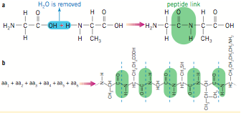

Slide 22
Polypeptides
The reaction of many amino acids produces a condensation polymer called a polypeptide, where hundreds or even thousands of amino acids are. Can you imagine how many millions of different combinations of sequences of twenty different amino acids there are? If there is a large enough number of amino acids involved, the polymer produced is called a protein rather than a polypeptide (the actual size distinction is somewhat arbitrary, but the molar mass for a protein is usually above 10 000 g mol−1).

